Slide 1
ZAS Academy
Python Curriculum for IOT & AI

Slide 2
Day1 - Agenda
Course Overview
Course Motivation
Python/IOT Curriculum (12 weeks)
Python/AI Curriculum (12 weeks)
Python Environment Setup
Python Data Types (Basic)
Python Data Types (Advanced)
Hands on exercises

Slide 3

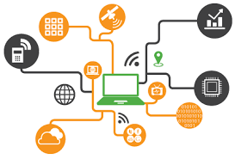
Journey Until Now
Microcontroller: BBC Microbit, Arduino and Raspberry PI
Sensors: 10-15 Different Sensors
Communication – Bluetooth, RF, Infrared, Keyboard, Blynk, WiFi etc.

Slide 4
Journey Until Now and What Next?
IOT
Machine Learning
MicroControllers & Sensors
Communication
Deep Learning
Computer Vision
Big Data
Autonomous Nav

Slide 5
Motivation - IOT

Slide 6
Motivation – Deep Learning Autonomous Car

Slide 7
Motivation – AI Autonomous Car

Slide 8
Python Learning Path (12 weeks)
15th
16th
20th
21st
22nd
23rd
Python Data Types
Python Algorithms
IGCSE Paper 2
IGCSE Paper 2
IO/Networking
Plotting
6th Apr to 11th Apr
Python Flask
Python Flask
IOT Architecture
Raspberry PI
Raspberry PI
Raspberry PI

Slide 9
Artificial Intelligence - Machine & Deep Learning (12 weeks)
Machine Learning - Maths
Linear Regression
Biological Inspiration
Neural Networks
Deep Learning
Deep Learning
AI – Autonomous Car
AI – Autonomous Car
AI – Autonomous Car
AI – Autonomous Car
AI – Autonomous Car
AI – Autonomous Car

Slide 10
Python Installation (Windows)
Follow the installation instructions shared with you

Slide 11
Python Installation (Mac)
Follow the installation instructions shared with you

Slide 12
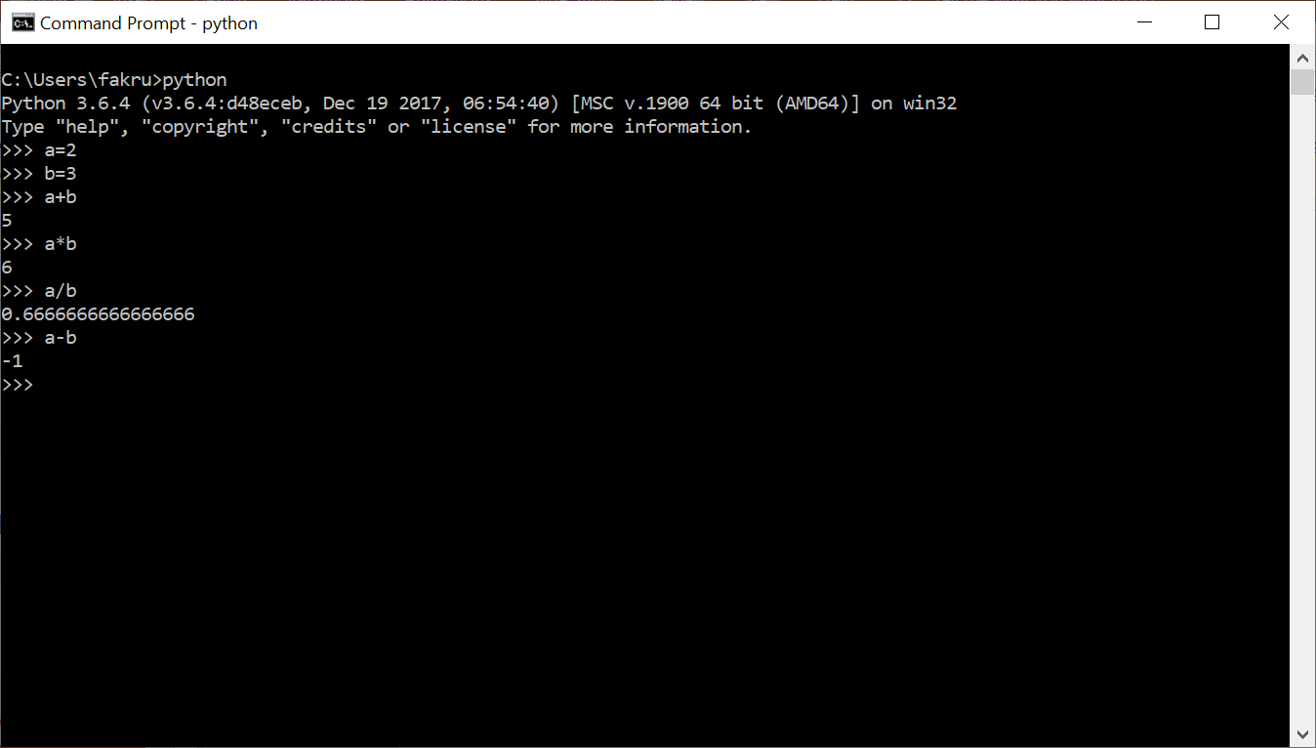
Python Terminal as Calculator

Slide 13
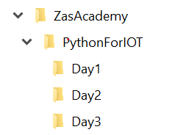
Python Directory Structure Setup
Create the following directory structure as working folder:

Slide 14
Python Script File
CD into the Day1 folder
Open any text editor and type the following code
Save the file as MyFirst.py
a=6
b=4
print('division', a/b)
print('addition', a+b)
print('subtract', a-b)
Open the windows command window or MAC terminal window

Slide 15
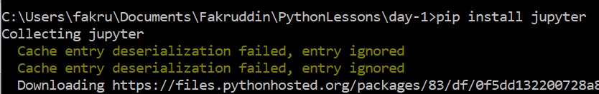
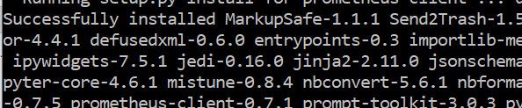
Jupyter Notebook Installation
Install the jupyter notebook by running the following command
pip install jupyter
or
pip3 install jupyter
If your installation is successful, you see the message like below

Slide 16
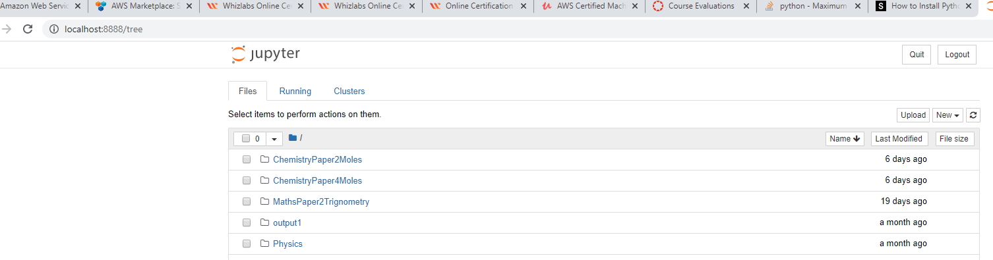
Run the Jupyter Notebook
From the command/terminal window run the following command to start the jupyter notebook
jupyter notebook
If it runs successfully, you should see a browser windows similar to the screen print shown below.

Slide 17
Python Data Types (Basic)
Int
Float
Double
Bool
String

Slide 18
Python Data Types (Basic)
Hands on Exercises

Slide 19
Python Data Types (Advanced)
Lists
Arrays
Set
Tuple
Dictionary

Slide 20
Python Data Types (Advanced)
Hands on Exercises

